Slide 1
Charging the Gaps:
Evaluating Electric Vehicle
Charging Deserts Along U.S. Interstates
GEOG 573 Drew Barkman, May Liu, Sam Leibowitz
Notes:
drew

Slide 2

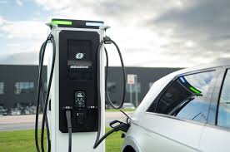
Introduction
Electric vehicles (EVs) are rising in popularity due to sustainability awareness
Rely on chargers, but infrastructure along U.S. interstates is still uneven, creating barriers to long‑distance electric travel (roadtrips!)
Varga et al. (2019): driving range is the primary factor influencing consumers’ decisions to adopt EV
Notes:
sam

Slide 3
Project Goal
Identify and visualize highway segments with highest need for EV chargers across the U.S.
  “Charging deserts”
Create customized priority ranking metric for EV charger implementation
  National Level
  Ranking metric considering:
    Vehicle miles traveled (VMT)
    Proximity to other EV chargers
Incorporate Network Analysis to further improve ranking method
  Case study: Twin Cities, MN
  Ranking metric considering:
    VMT
    Proximity to other EV chargers
    Betweenness centrality: higher betweenness = greater need
Identify list of top 10 highest priority area/ZIP code & visualize
Notes:
sam

Slide 4
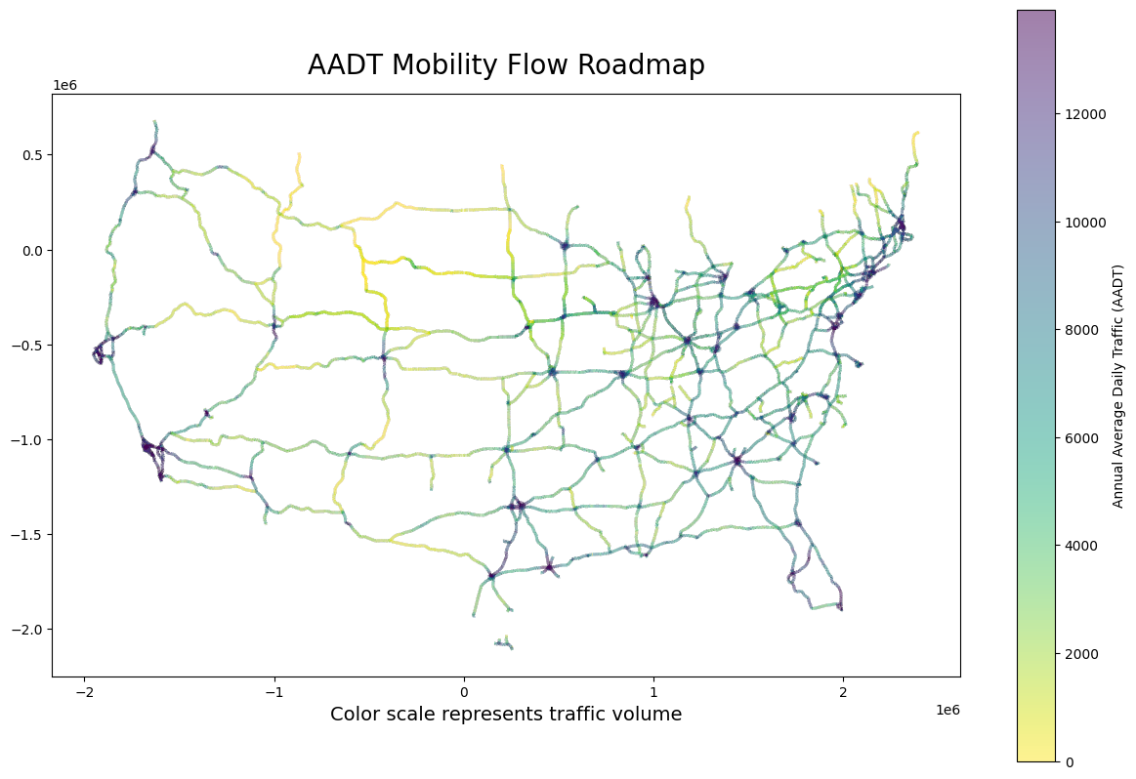
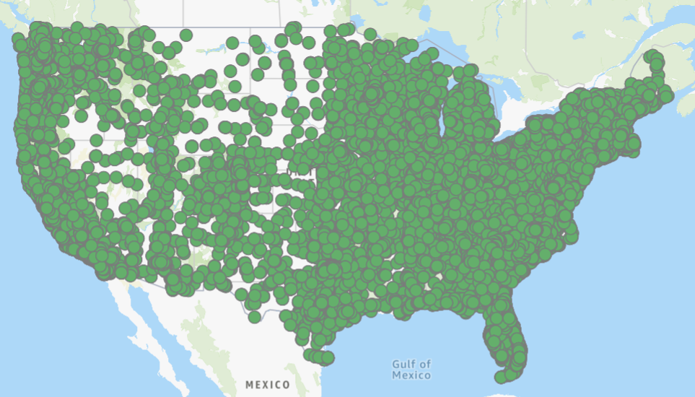
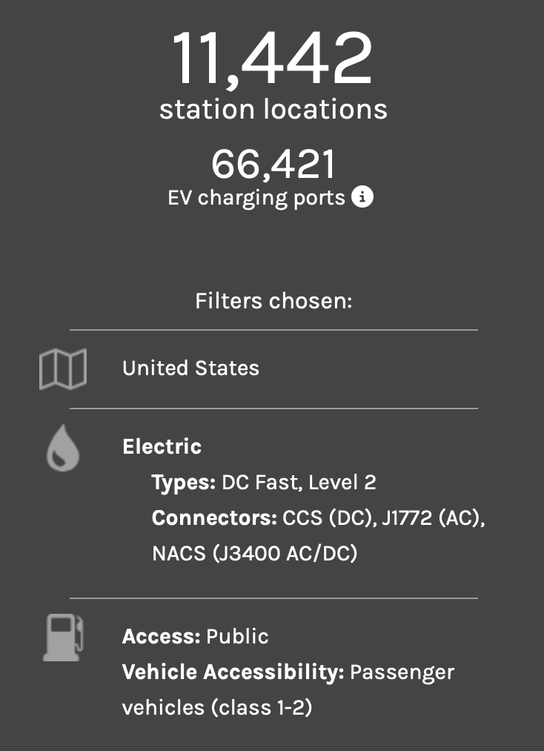
Data
EV Charging Stations
Interstate & Mobility Flow
Source: U.S. Department of Energy’s Alternative Fuels Data Center (AFDC)
Source: U.S. Department of Transportation
.csv with columns i.e. station location, access type, charging level, connector type, and operational status
Filtered to reflect non‑commercial, long‑distance personal travel (roadtrips)
TIGER shapefiles, ZCTA, geojson
https://afdc.energy.gov/fuels/electricity-locations#/analyze?country=US&tab=station&fuel=ELEC&ev_connectors=J1772&ev_connectors=TESLA&ev_connectors=J1772COMBO
https://data.transportation.gov/stories/s/Data-Access-for-Highway-Performance-Monitoring-Sys/3uu4-47sa/#national-highway-system
Notes:
may
Data background & selection
EV Charging Stations database (AFDC)
selected & filtered data
NHTSA mobility flow data (care about AADT)
Cleaned the data
Visualized 25-mi radius around each charging location

Slide 5
Methodology/Workflow
1
2
3
Data Processing &
Preliminary Analysis
STAGE 1:
Creating Priority Score System
STAGE 2:
Incorporating Network Analysis
Create customized score for ranking
Large Scale
Entire U.S.
Score = VMT * Dist. from Charger
Small Scale
Twin Cities, MN
Score = VMT *
(Dist. from Charger)* (Betweenness)
OSMnX, NetworkX
Visualize traffic flow and charger location
AADT, 25-mi radius service area
Notes:
may

Slide 6
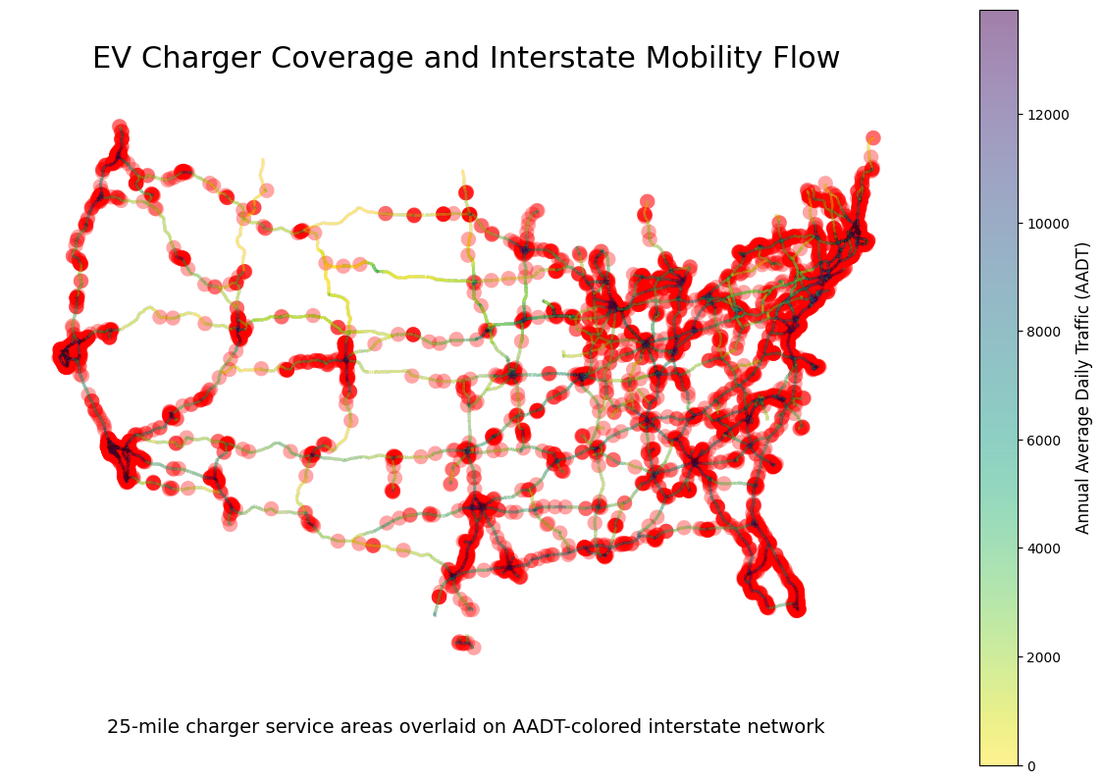
Preliminary Analysis
National‑scale map of EV charging accessibility
Chargers < 5mi from interstates
25‑mile radius service areas buffer
  2025 NEVI Guidelines
Overlay interstate traffic volumes using Average Annual Daily Traffic (AADT) as mobility metric
Highlight where high‑demand corridors lack adequate charging coverage
Notes:
may

Slide 7
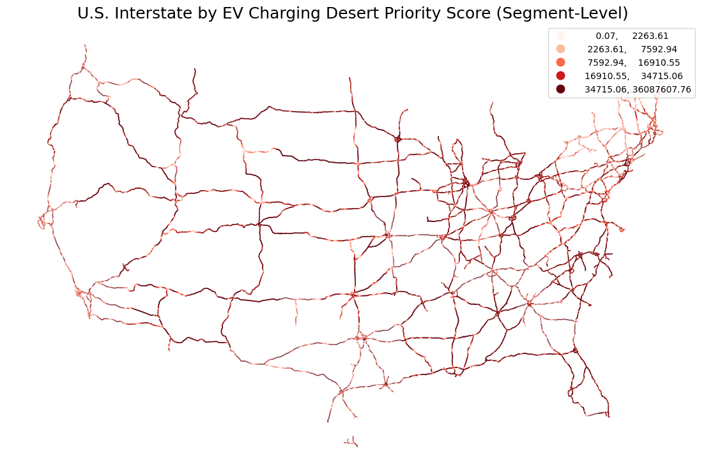
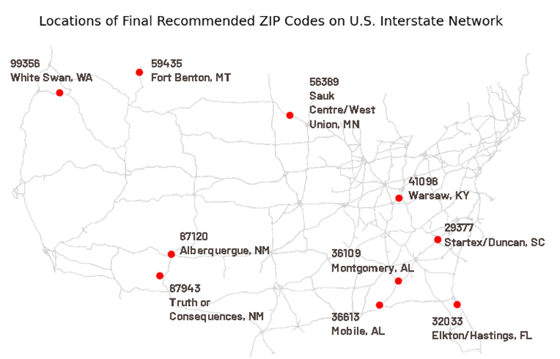
Analysis - Stage 1:
Create a Priority Scoring System
25 mi buffers and AADT mobility flow is nice, but…
  AADT: treats every segment as if it were the same length
  25 mi buffers: segments are either “within range” or “not
Solution:
  Standardize AADT: aka VMT, Vehicle Miles Traveled
  use “distance from charger”
Score =
VMT * (Dist. from Nearest Charger)
Results: a list of top ten priority area ZIP codes with highest scores (need EV chargers most)
Notes:
drew
AADT: (ie. short urban connector with high traffic is just as importantas major highways)
25 mi: 1 mi away and 29.9 mi away is treated the same

Slide 8
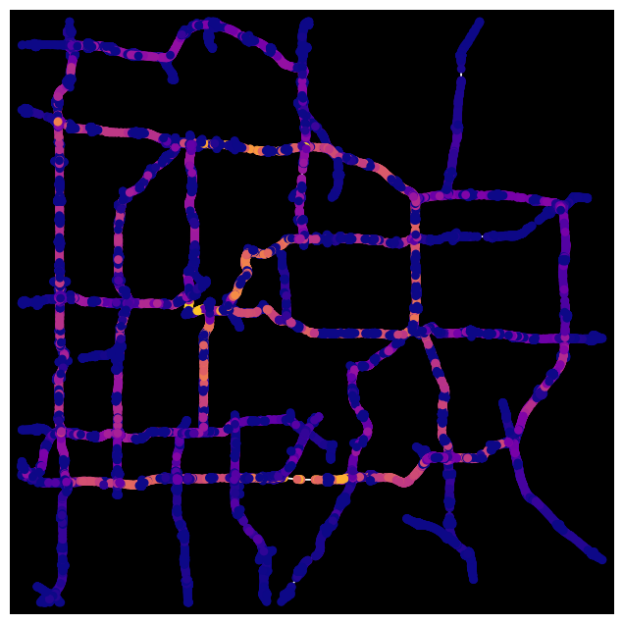
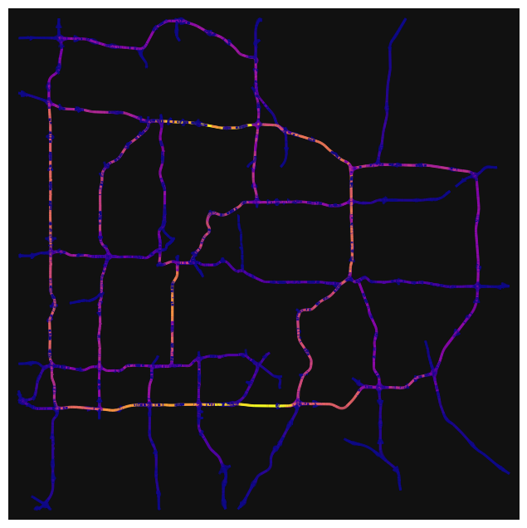
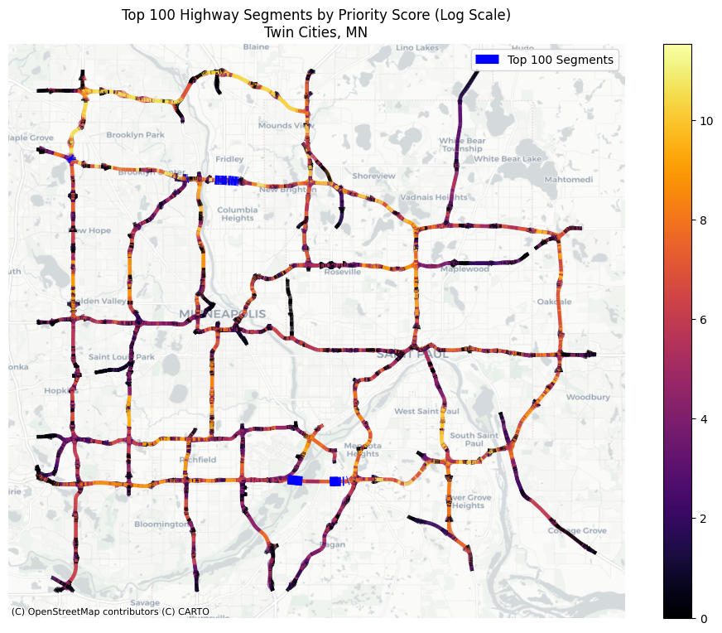
Analysis - Stage 2:
Incorporating Network Analysis
VMT and distance from chargers are important, but…
  Neither shows how essential a road is for connecting roads across the network.
  Add in Betweenness Centrality!
Down scale to Twin Cities, MN as demonstration
Using OSMnX and NetworkX
Create more robust scoring system
Results: 5 aggregated segments with top scores
Betweenness Centrality
Edge Centrality
Score =
VMT * (Dist. from Nearest Charger)* (Betweenness Centrality)
Notes:
sam

Slide 9
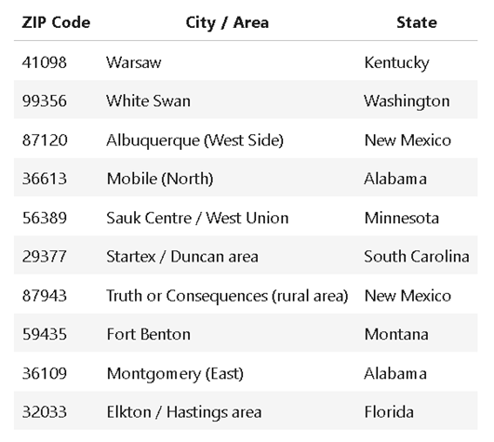
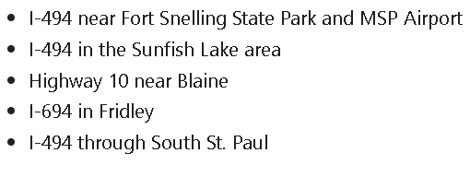
Results & Conclusion
U.S. Top 10 ZIP-code areas
for EV Charger Implementation
Conclusion
National map reveals major charging deserts
Network analysis pinpoints structurally critical gaps
  Betweenness centrality
Priority score ranks top corridors for investment
Targeted fast‑charging deployment improves EV mobility and system robustness
Future research gaps:
Charger reliability, power levels, and real‑time availability were not incorporated
Future work could integrate dynamic routing models, temporal traffic patterns, or simulations of EV adoption scenarios
Twin Cities Top 5 Suggested Areas
for EV Charger Implementation
Notes:
sam

Slide 10
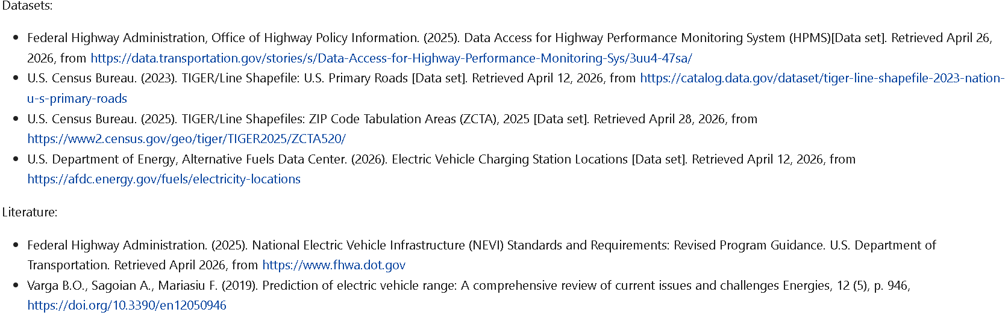
THANKS!
References
Notes:
sam

